Slide 1

Varendra University
Dept. of Computer Science & Engineering (CSE)
Arrays and Addressing Modes (Chapter-10)
Course Title: Microprocessor and Assembly Language
Course No: CSE 3205
Prepared By:
Md. Adnan Sami
Lecturer, Dept. of CSE, VU

Slide 2
Outline
  One Dimensional Array.
  Two Dimensional Array.
  Assignment.

Slide 3
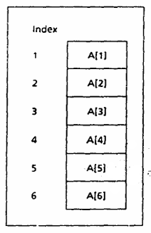
One Dimensional Array

Slide 4
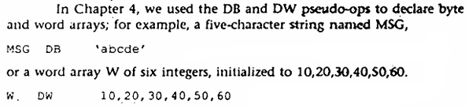
One Dimensional Array

Slide 5
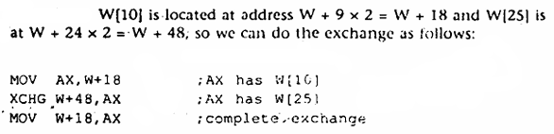
One Dimensional Array
  Example 10.1: Exchange the 10th and 25th elements in a word array W.
  Solution:

Slide 6
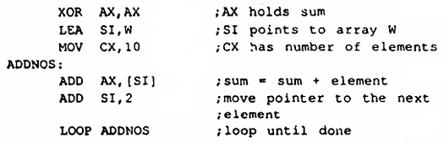
One Dimensional Array
  Example 10.3: Write some code to sum in AX the elements of the 10-element array W defined by,
  W DW 10, 20, 30, 40, 50, 60, 70, 80, 90, 100
  Solution:

Slide 7
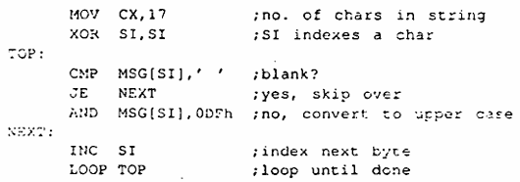
One Dimensional Array
  Example 10.7(*): Replace each lowercase letter in the following string by its upper case equivalent. Use index addressing mode:
  MSG DB 'this is a message’
  Solution:

Slide 8
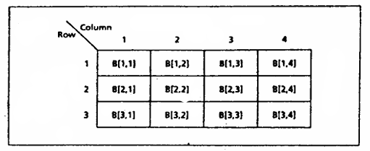
Two Dimensional Array

Slide 9
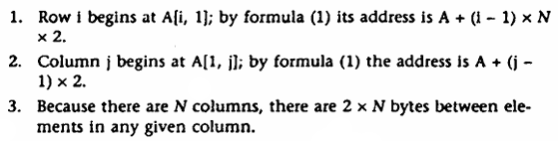
One Dimensional Array
  Example 10.12: Suppose A is an M × N word array stored in row-major order.
    Where does row i begin?
    Where does column j begin?
    How many bytes are there between elements in a column?
  Solution:

Slide 10
Assignment
  Write a code in assembly language which will reverse an array of N words.
  Source:
  Example 10.4 (Chapter 10).
  Book: Assembly Language Programming and Organization of the IBM PC.
  Writer: Ytha Yu, Charles Marut.

Slide 11
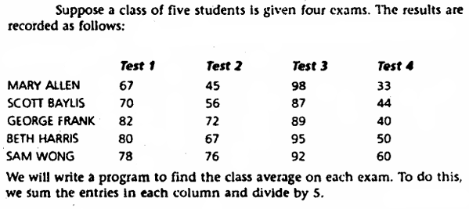
Assignment
  Source:
  Example 10.6 (Chapter 10).
  Book: Assembly Language Programming and Organization of the IBM PC.
  Writer: Ytha Yu, Charles Marut.

